Slide 1


Introduction & Conclusion
W
Ch2
Ch3
Ch4
Ch5
Ch6
Welcome
Lit. Review
Methodology
Design
Results
Introduction & Conclusion
A report
Well
Structured
6th part of the guided research track (GRT)
RRSG Seminar
Finishing the most-read chapters last
Prepared by Dr. Simon Winberg
Notes:
This presentation was prepared for the ‘guided research track’ (GRT) for students starting on a research thesis.

Slide 2
Outline
Amit :
Using mindmaps to structure your write-up
Rubric
The Project
Where are you and where you’ve been
Introduction
Conclusion

Slide 3

Where are you now on your project?
?

Slide 4





Where you might be…
Well pleased with yourself, but have that sinking feeling you may have ended up in the wrong place
Happily on top of the world, successful past all problem of the thesis
Haven’t a clue where you are!
Hoping things will happen magically especially if you are sufficiently cute and confused
Doing the finishing touches
A report
Well
Structured
Aware of some problems but hoping no one will see them

Slide 5

The last week and a bit (phase 6)
start
A suggested approach
1
1
Initial meeting with supervisor
2
The Proposal
Start Literature
Review (take1)
You are here (?!)
2
2
6
Deciding on & ordering components
Prepare Initial Attempt at ELO tracking form
Finish off the report
3
Work on Report Chapters
Main Development Design & Develop
Initial Exploration Design & Develop
5
4
Refine Methodology and Experiment Design
Experiment
Revise Literature
Revise Literature
ends

Slide 6
The Introduction…
Serious Stuff.

Slide 7
The Introduction
There are a whole lot of reasons why you need a good introduction…
I’ll give you
3
reasons…

Slide 8
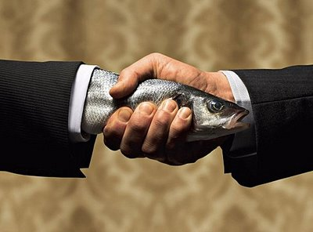


#1 Reason for a good Introduction
It’s the first impression…
&
First impressions count alot and say alot about you.
The needy handshake
“Oh dear, this is a drag”
Deadfish handshake
“I really shouldn’t have…”
(and what the examiner might think)
Good handshake
“Yes – We’re in business!”

Slide 9
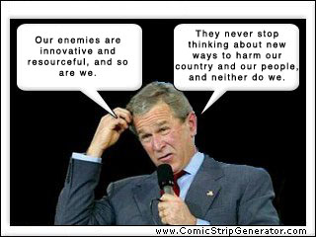

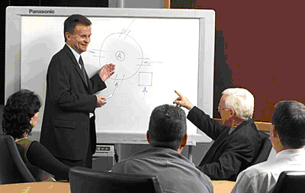
#2 Reason for a good introduction
to Show you Know
(to show you can ‘talk like a professional’ and have a good logical structure)
You don’t want to
show that you don’t know
You don’t want to make a confusing mess of things
Yes – you want to show you are a professional and can engage with other professionals

Slide 10
#3 Reason for a good introduction
to Explain
(Giving a clear explanation of what you’re going to do and why)
Focus
What
Why

Slide 11
Introduction Flow
This
is the objective
This is the scoped and what will be done
This is how it came about & the broader influences

Slide 12
The Introduction
NB!
State objective and brief overview
Lead-in to background and motivation
Important Terminology
Background / Motivation
Objective / Hypothesis
Problem description
Focus
Scope and limitations
Document outline
NB!
NB!
NB!
NB!
NB!
NB!
Parts you really should have

Slide 13


Draft Introduction(s)
The introduction should have been a work in progress from around the first week (to record what the project is about)
But I tend to think there isn’t much point in spending much time on the introduction until you’ve actually got most of your results together.
These should at least provide:
Objective + Possibly sub-objectives
Motivation
Background
(Focus – things to do, eg. To build)
Scope and limitations

Slide 14
Final Introduction
This should just be a process of updating and refining your Draft Introduction
Should at least provide:
Objective + Possibly sub-objectives
Motivation
Background
(Focus – things to do, eg. To build)
Scope and limitations

Slide 15

Conclusions
Summary and discussion of main results / funding
Reflect back on the objective
Need to show some integration with other parts of the manuscript
MAIN THING - You’ve demonstrated
“Captaincy” : you’ve understood the project and done what is needed
“Contingency” : you’ve shown ways that it can be taken further and scope for refinement/additions

Slide 16

W
Ch2
Ch3
Ch4
Ch5
Ch6
Welcome
Lit. Review
Methodology
Design
Results
Introduction & Conclusion
Questions?

